Slide 1
Understanding the View
View: A Python function or class that returns an HTTP response.
A view in Django is just a Python function (or class) that receives a web request and returns a web response.

Slide 2
Basic View Function
Create or open the views.py file in your app directory (e.g., myapp/views.py), and define a view: # myapp/views.py
from django.http import HttpResponse
def home(request):
return HttpResponse("Hello, this is the homepage!")

Slide 3
Mapping the View to a URL
Next, connect this view to a URL pattern in your urls.py file.
If you don't already have a urls.py in your app, create it:
myapp/urls.py # myapp/urls.py
from django.urls import path
from . import views
urlpatterns = [
path('', views.home, name='home'),
]

Slide 4
Now include this in the project’s main urls.py (in the project folder):
# projectname/urls.py
from django.contrib import admin
from django.urls import path, include
urlpatterns = [
path('admin/', admin.site.urls),
path('', include('myapp.urls')), # Link app URLs
]

Slide 5
Run the Server and Test
python manage.py runserver
Visit http://127.0.0.1:8000/ — You should see: Hello, this is the homepage!

Slide 6
Creating views and view logic in Django
In Django, views and view logic define how your application responds to user requests. Views retrieve data from the database (via models), process it (logic), and render responses (often using templates).

Slide 7
Even-Odd View in Django
1. View Logic (Function-Based View) # myapp/views.py
from django.http import HttpResponse
from django.shortcuts import render
def even_odd(request):
a=1001
if(a%2==0):
return HttpResponse("EVen")
else:
return HttpResponse("Odd")
# myapp/urls.py
path("even_odd",views.even_odd),

Slide 8
HTTP Requests
In Django, HTTP requests are handled through the request object passed to each view.
When a client (like a browser or API tool) makes a request to your Django server, Django captures this as a HttpRequest object and passes it to the view function:
def my_view(request):
# request.method will be "GET", "POST", etc.

Slide 9
#views.py
def get_api_data(request,id):
url = f'https://jsonplaceholder.typicode.com/posts/{id}'
response = requests.get(url)
if response.status_code == 200:
data = response.json()
return JsonResponse(data)
else:
return JsonResponse({'error': 'Failed to fetch data'}, status=500)

Slide 10
url.py path("api-data/<id>", views.get_api_data, name='api-data')

Slide 11
Creating requests and Responses
Creating requests is handled automatically
by the framework when a user accesses a URL, and your job as a developer is to handle the request and send back a response.
Basic Flow: Request → View → Response
User sends a request (e.g., clicks a link or submits a form).
Django receives it and sends it to the appropriate view.
View processes the request and returns an appropriate HttpResponse.

Slide 12
#1. myapp/views.py def simple_view(request):
# Request comes here from the browser
name = request.GET.get('name', 'Guest')
# Reading 'name' from the URL query
return HttpResponse(f"Hello, {name}!")
#myapp/urls.py
path('welcome/', views.simple_view),

Slide 13
2. #views.py
from django.http import JsonResponse
def json_view(request):
data = {"name": "Lalit", "age": 28}
return JsonResponse(data) To install the requests library in Python, which is used for making HTTP requests (typically in clients, not in Django views), use the following command:
pip install requests

Slide 14
After installing, you can check it with:
pip show requests
After that import requests in views.py Then, #urls.py path('lalit/', views.json_view),

Slide 15
You only need requests if you're making outgoing HTTP requests from Django to another service/API. For example:
import requests
def fetch_data():
response = requests.get('https://api.example.com/data')
data = response.json()
return data
You don’t need requests to handle incoming requests — Django does that natively.

Slide 16
Understanding URL‘s
URLs in Django is essential because URLs map browser requests to the appropriate views. Django uses a powerful and flexible URL dispatcher to route URLs to views.
urls.py defines the patterns of URLs your app responds to and maps them to views (functions or classes).

Slide 17
1. Basic URL Mapping
# myapp/views.py
from django.http import HttpResponse
def homepage(request):
return HttpResponse("Welcome to my site!")
# myapp/urls.py
from django.urls import path
from . import views
urlpatterns = [
path('', views.homepage, name='home'), # root URL
]
Now when someone visits http://127.0.0.1:8000/, they will see “Welcome to my site!”

Slide 18
2. Including App URLs in Project
Include your app’s urls.py in the project-level urls.py (e.g., in the folder created by startproject): # project/urls.py
from django.contrib import admin
from django.urls import path, include
urlpatterns = [
path('admin/', admin.site.urls),
path('', include('myapp.urls')), # Link to app's URLconf
]

Slide 19
3. URL with Parameters
You can pass values directly in the URL using
angle brackets:
# myapp/views.py
def greet(request, name):
return HttpResponse(f"Hello, {name}!")
# myapp/urls.py
urlpatterns = [
path('greet/<str:name>/', views.greet, name='greet_user'),
]

Slide 20
Example URL: http://127.0.0.1:8000/greet/Lalit/ → Output: Hello, Lalit!

Slide 21
4. URL Converters
Converter | Description | Example
<int:val> | Integer | 123
<str:val> | String (default) | hello
<slug:val> | Slug string | my-blog-post
<uuid:val> | UUID | 23ddc...
<path:val> | String with slashes | a/b/c/
Converter | Description | Example
<int:val> | Integer | 123
<str:val> | String (default) | hello
<slug:val> | Slug string | my-blog-post
<uuid:val> | UUID | 23ddc...
<path:val> | String with slashes | a/b/c/

Slide 22
Mapping urls with parameters
#myapp/views.py def sitedata(request,name):
return HttpResponse(f"{name}") #myapp/urls.py
path("sitedata/<name>",views.sitedata),
path("sitedata3/<str:name>",views.sitedata),

Slide 23
Multiple Parameters Example
def add(request, a, b):
return HttpResponse(f"The sum of {a} and {b} is {a + b}")
path('add/<int:a>/<int:b>/', views.add, name='add'),
http://127.0.0.1:8000/add/5/10/
The sum of 5 and 10 is 15

Slide 24
#myapp/views.py def sitedataINT(request,id):
return HttpResponse(f"{id}")
#myapp/urls.py
path("sitedata1/<int:id>",views.sitedataINT),

Slide 25
View
def view_data(request, item_id):
return HttpResponse(f"UUID received: {item_id}")
url path('data/<uuid:item_id>/', views.view_data),

Slide 26
Regular Expression in urls
Django allows you to define complex URL patterns using regular expressions with re_path() instead of path().
1. When to Use re_path()
Use re_path() when:
You need more precise control than path() gives.
You want to match patterns like optional trailing slashes, specific word formats, etc.

Slide 27
Regular Expression in urls
from django.urls import re_path
from . import views
Views.py
def say_hello(request):
return HttpResponse("Hello from regex URL in Django!")
urlpatterns = [
re_path(r'^hello/$', views.say_hello),
]

Slide 28
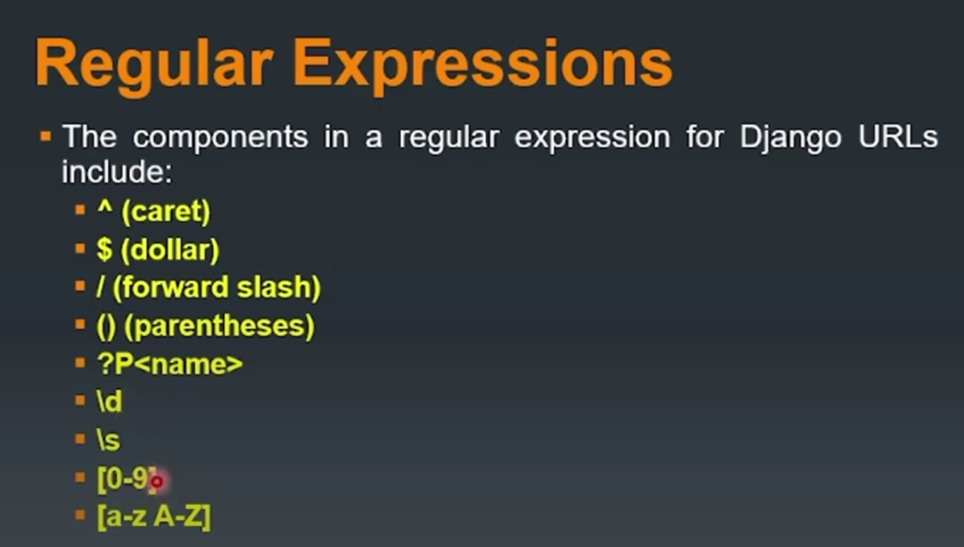

Slide 29
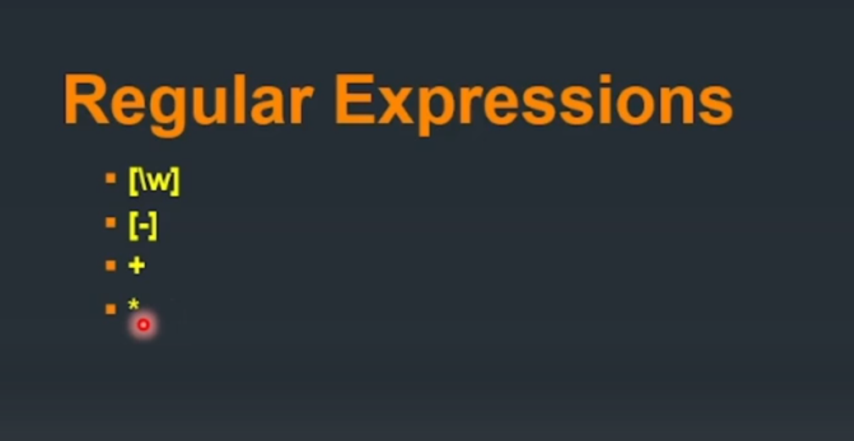

Slide 30
URL with Integer ID
Views.py def user_detail(request, id):
return HttpResponse(f"User ID is: {id}")
Urls.py path('user/<int:id>/', views.user_detail),

Slide 31
Alphanumeric Username
Views.py
def profile(request, username):
return HttpResponse(f"Welcome, {username}")
Urls.py re_path(r'^profile/(?P<username>[a-zA-Z0-9_]+)/$', views.profile),

Slide 32
Views.py def report(request, date): return HttpResponse(f"Report for date: {date}") urls.py re_path(r'^report/(?P<date>\d{4}-\d{2}-\d{2})/$', views.report)

Slide 33
Error Handling
Django provides robust tools for handling errors and exceptions in your web application. You can manage:
Built-in errors (404, 500, etc.)
Runtime exceptions in views
Custom error pages
Form validation errors

Slide 34
1. Handling Common HTTP Errors
Custom 404 (Page Not Found) ➤views.py
from django.shortcuts import render
def custom_404(request, exception):
return render(request, '404.html', status=404)
➤ urls.py (Project-level) handler404 = 'myapp.views.custom_404'

Slide 35
➤ templates/404.html
<h1>404 - Page Not Found</h1>
<p>The page you requested does not exist.</p>

Slide 36
Custom 500 (Internal Server Error)
➤ views.py def custom_500(request):
return render(request, '500.html', status=500)
➤ urls.py ➤handler500 = 'myapp.views.custom_500‘
templates/500.html
<h1>500 - Server Error</h1>
<p>Something went wrong. Please try again later.</p>
You must disable debug mode (DEBUG = False in settings.py) for custom error handlers to work.

Slide 37
2. Handling Exceptions in Views
Use try-except blocks to catch runtime errors and return user-friendly messages. from django.http import HttpResponse, Http404
def divide_view(request):
try:
x = int(request.GET.get("x", 0))
y = int(request.GET.get("y", 1))
result = x / y
return HttpResponse(f"Result: {result}")
except ZeroDivisionError:
return HttpResponse("Error: Cannot divide by zero")
except (ValueError, TypeError):
return HttpResponse("Invalid input values.")

Slide 38
Raising 404 in Views
If an object is not found in the database: from django.shortcuts import get_object_or_404
from .models import User
def user_detail(request, user_id):
user = get_object_or_404(User, pk=user_id)
return HttpResponse(f"User: {user.name}")

Slide 39
Or manually: from django.http import Http404
def view_func(request, id):
if id != 123:
raise Http404("Item not found")

Slide 40
4. Form Validation Errors
Django handles form errors with automatic validation:
# forms.py
from django import forms
class NameForm(forms.Form):
name = forms.CharField(max_length=100)
# views.py
def get_name(request):
if request.method == "POST":
form = NameForm(request.POST)
if form.is_valid():
return HttpResponse("Form is valid!")
else:
form = NameForm()
return render(request, "name_form.html", {"form": form})

Slide 41
In the template:
<form method="post">
{% csrf_token %}
{{ form.as_p }}
<button type="submit">Submit</button>
</form>
Django will automatically show error messages if validation fails.

Slide 42
5. Logging Errors
Enable error logging in settings.py to store error reports:
LOGGING = {
'version': 1,
'handlers': {
'file': {
'level': 'ERROR',
'class': 'logging.FileHandler',
'filename': BASE_DIR / 'error.log',
},
},
'loggers': {
'django': {
'handlers': ['file'],
'level': 'ERROR',
'propagate': True,
},
},
}

Slide 43
Error Type | Handler | Purpose
404 Not Found | handler404 | Page doesn't exist
500 Server Error | handler500 | Server crashed
View Error | try-except | Runtime issues like division
Object Not Found | get_object_or_404 | Missing database entry
Form Validation | form.errors | Invalid user input
Logging | LOGGING config | Write to file or console

